Slide 1
Grounding inductive biases in natural images: invariance stems from variations in data
Ari Morcos
FAIR

Slide 2


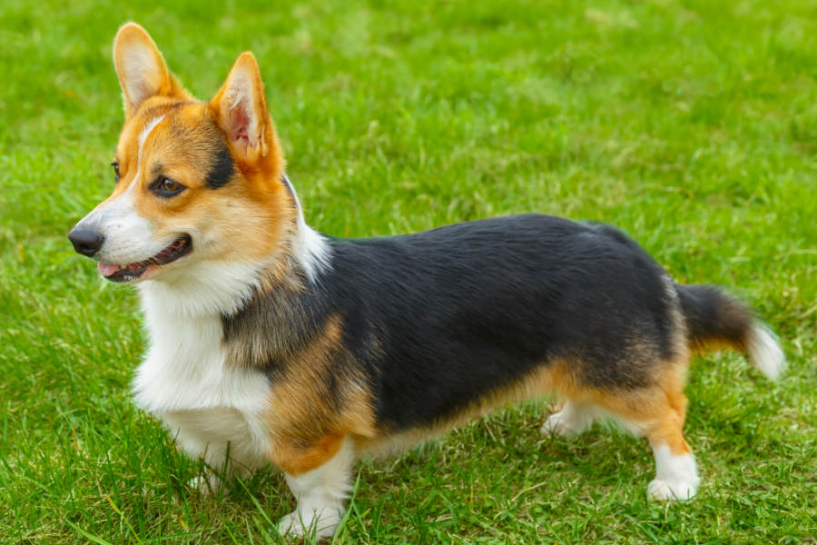
Why is invariance important?
We want models to generalize to new, unseen instances
Models should be sensitive to changes in semantic content
Models should be invariant to changes in nuisance content
Should be invariant to change in pose
Should be sensitive to change in breed

Slide 3
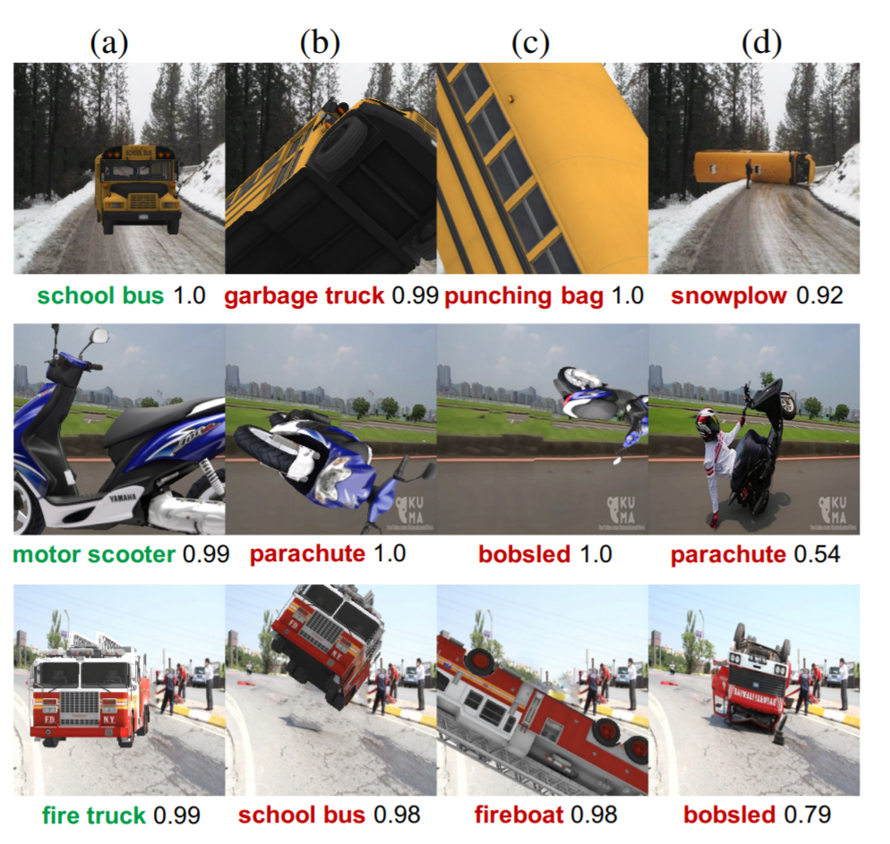
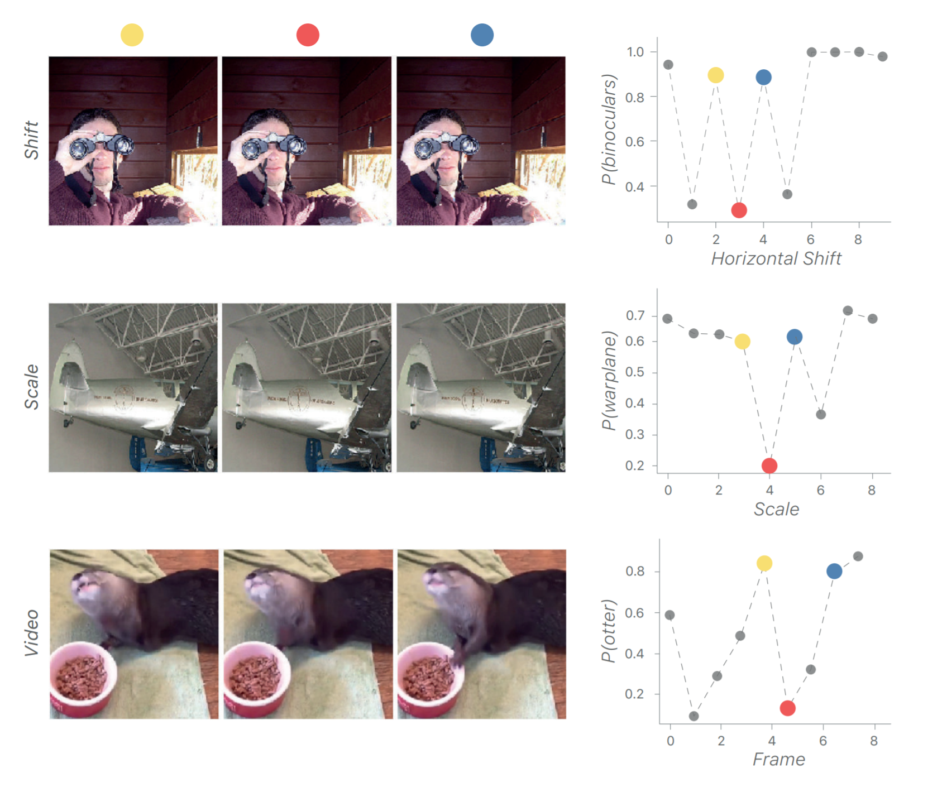
Why is invariance important?
Models are often highly sensitive to:
Changes in pose
Slight transformations in the input
Alcorn et al., 2019
Azulay and Weiss, 2019

Slide 4
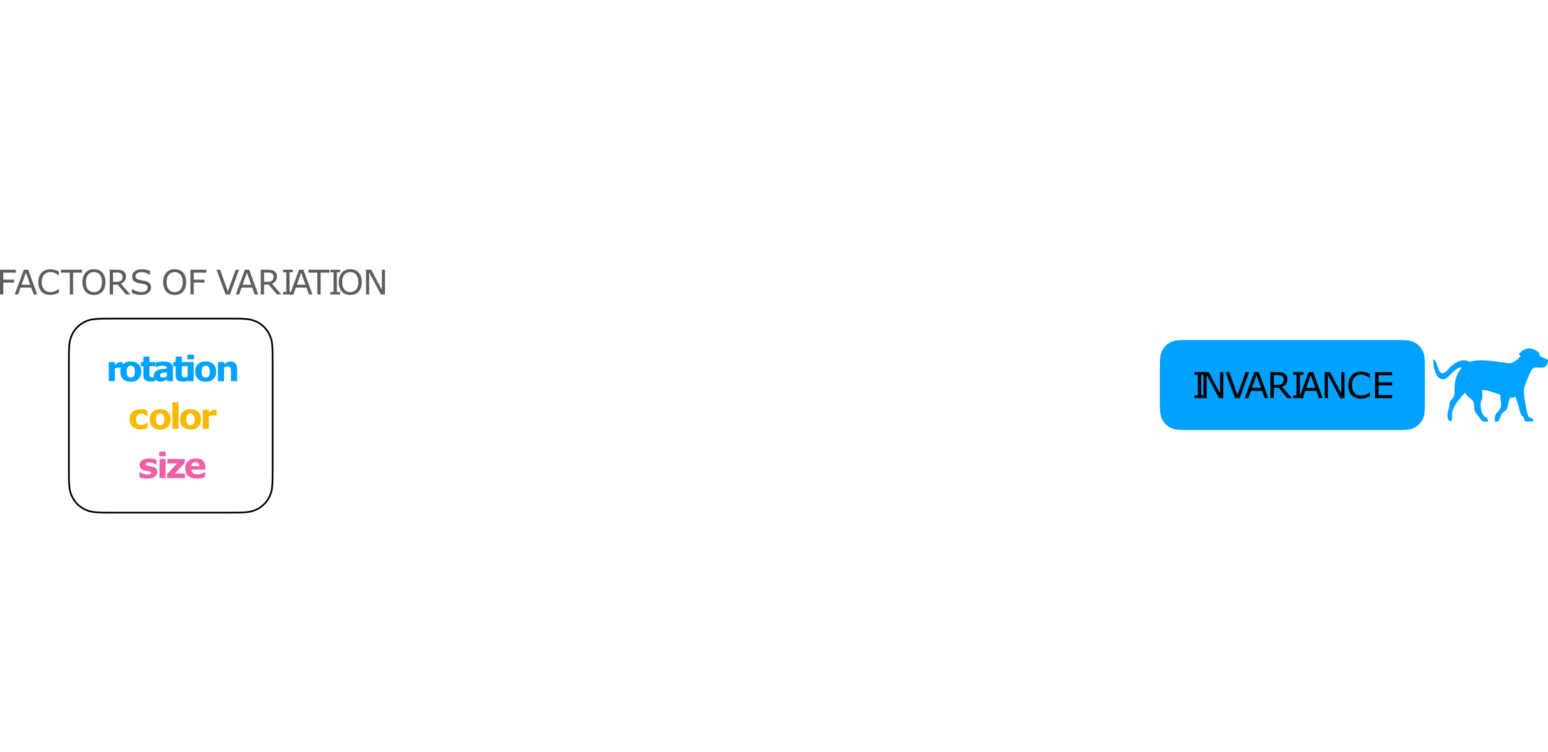
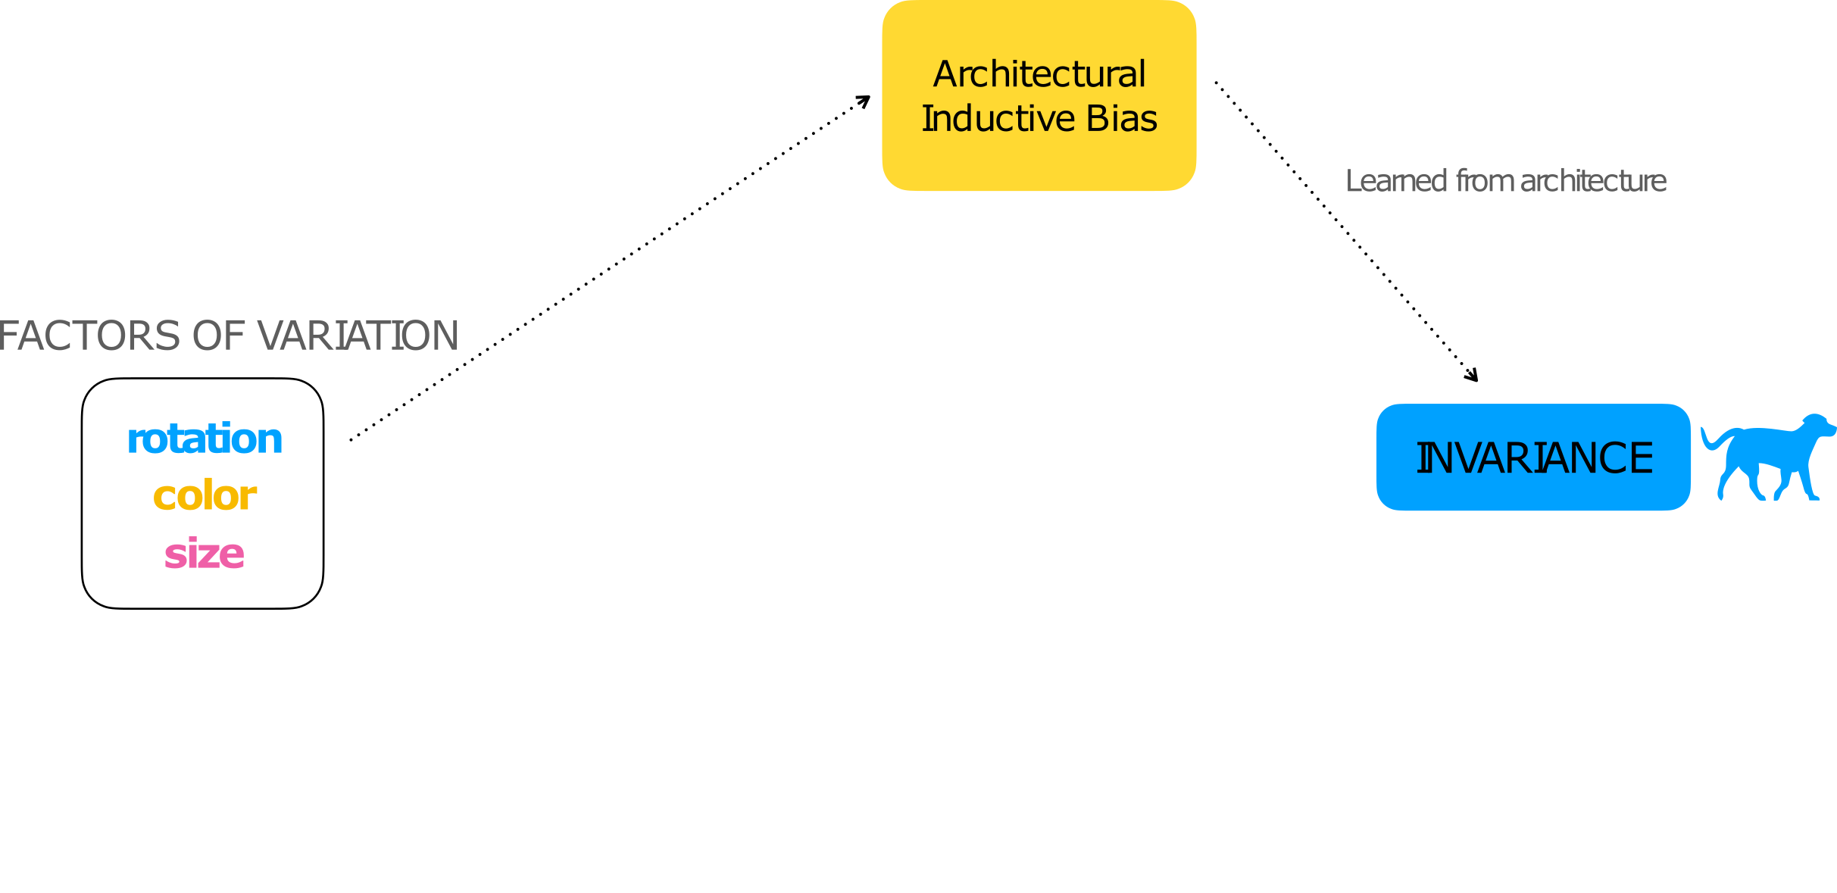
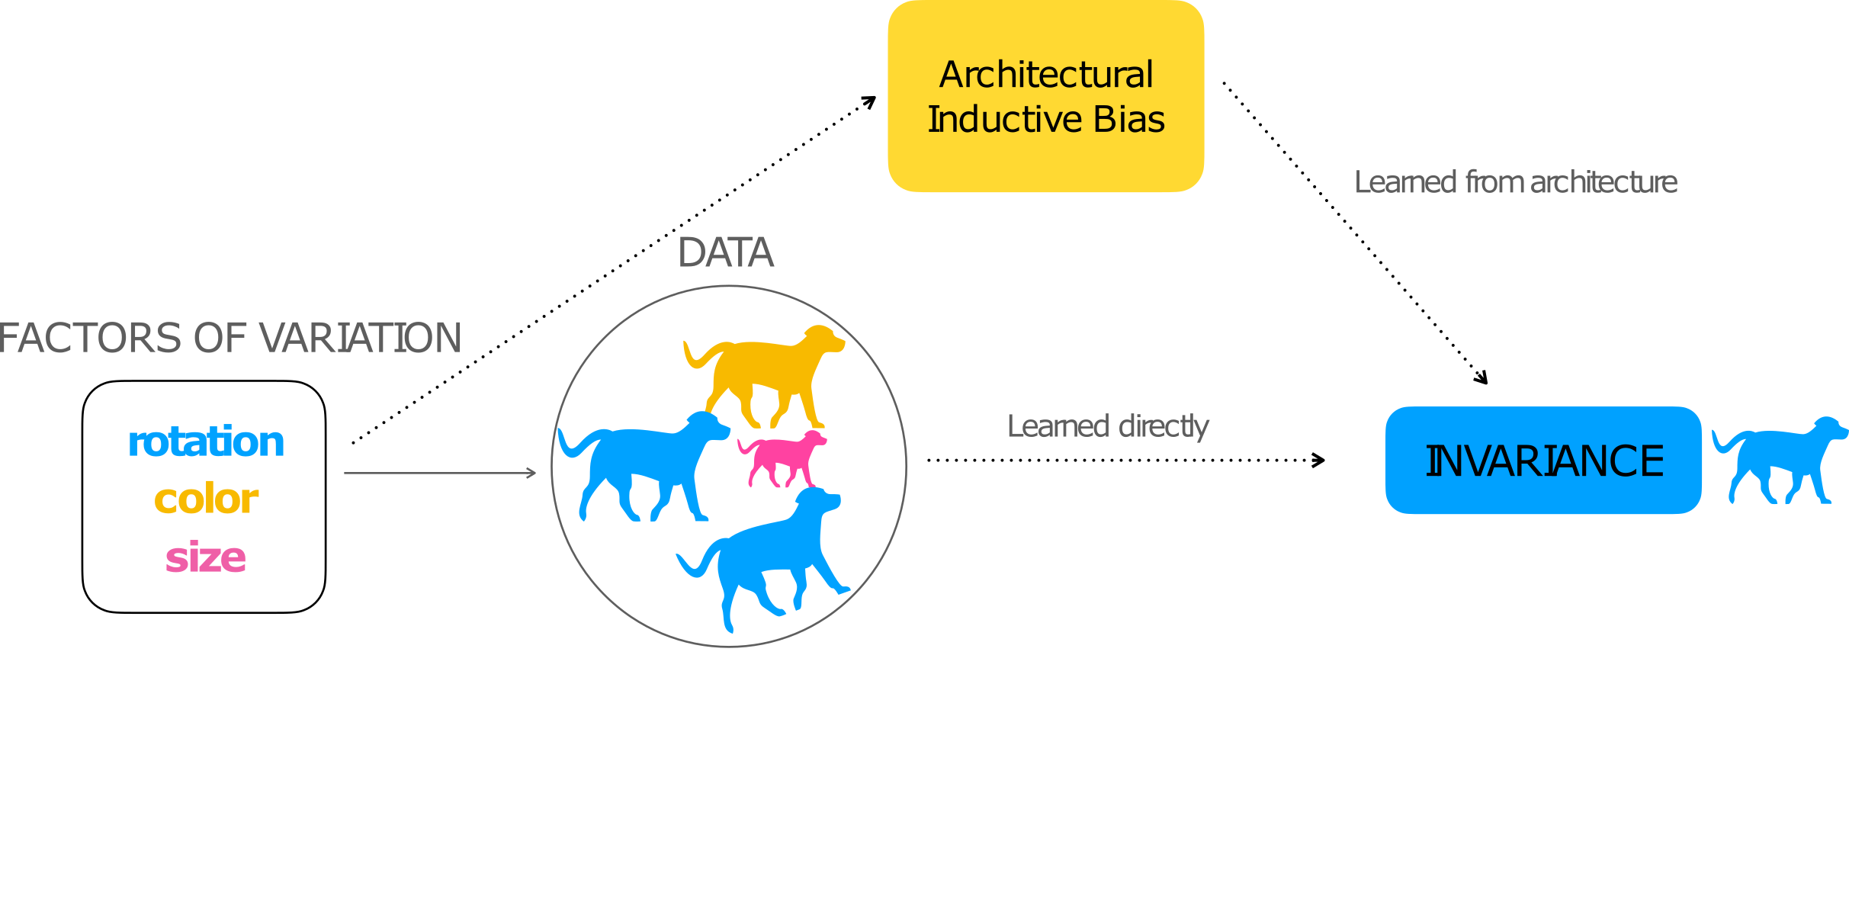
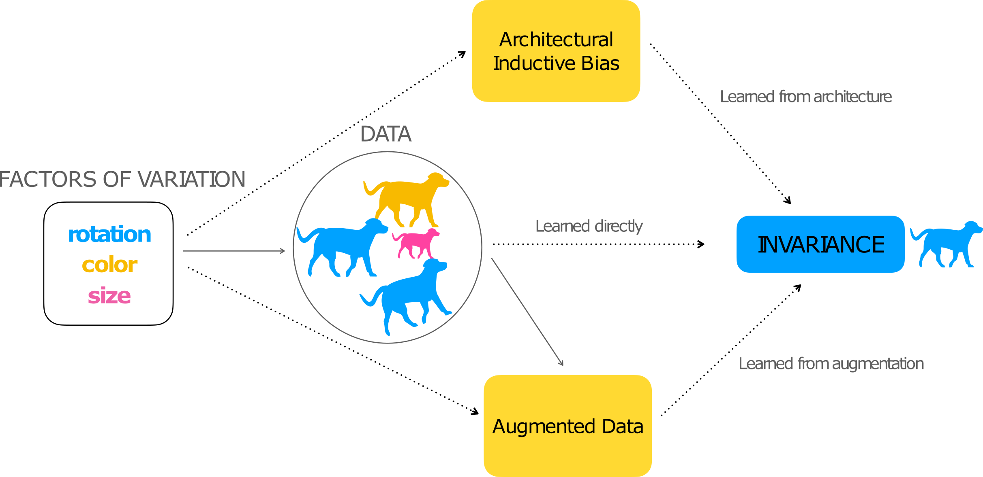

What is the source of invariance?
What invariance is present?

Slide 5
Our current understanding of the source of invariance
Architecture
Part of the original motivation for CNNs was that they were roughly shift-invariant (LeCun et al., 1989)
However, a number of recent works have found cases where CNNs are susceptible to shifts (Azulay and Weiss, 2019, Kayhan and Gemert, 2020)
Data augmentation
Current standard practice is to design a data augmentation to encuourage invariance
However, training with an augmentation does not necessarily confer invariance (Engstrom et al., 2019)

Slide 6
Decomposing random resized crop

Slide 7
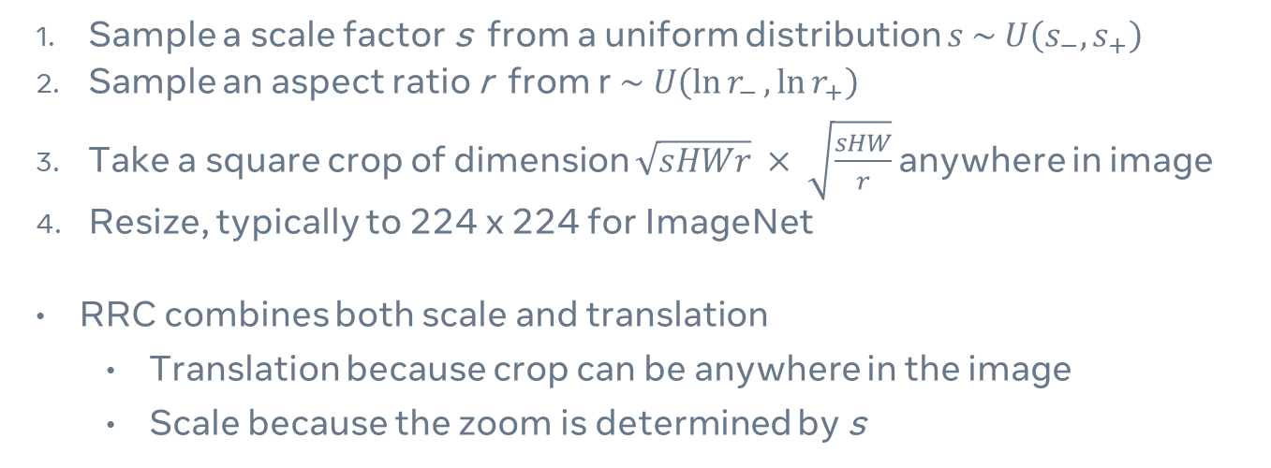
Understanding Random Resized Crops (RRC)
Sample a scale factor s from a uniform distribution $s \sim U\left(s_{−}, s_{+}\right)$
Sample an aspect ratio r from r$\sim U\left(\ln{r_{−}},\ln{r_{+}}\right)$
Take a square crop of dimension $\sqrt{sHWr} × \sqrt{\frac{sHW}{r}}$anywhere in image
Resize, typically to 224 x 224 for ImageNet
RRC combines both scale and translation
Translation because crop can be anywhere in the image
Scale because the zoom is determined by s
What is the relative contribution of scale vs. translation in the success of RRC?
Notes:
Since CNNs are approximately translation invariant, we might expect that the main benefit stems from scale, not translation

Slide 8
Decomposing RRC: approach
Separate RRC into its component parts: translation and scale
Evaluate performance of standard ResNet50 on ImageNet in the presence of varying combinations of translation and scale augmentation

Slide 9
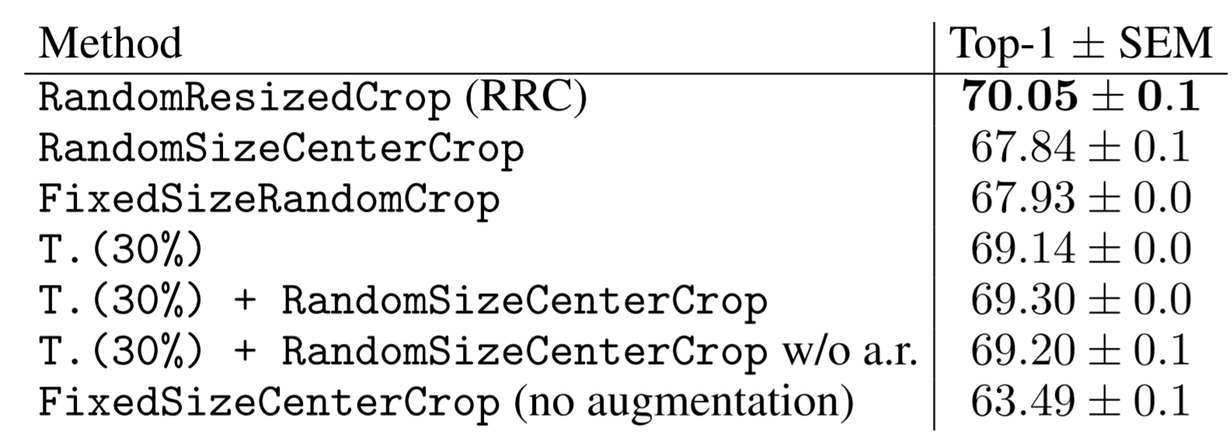
Decomposing RRC shows that translation is more important than scale
Impacts scale, but not translation
Impacts translation (within image), but not scale
Impacts translation (up to 30% height/width), but not scale
T(30%) + scale
T(30%) + scale without allowing aspect ratio change

Slide 10
Decomposing RRC shows that translation is more important than scale
Impacts scale, but not translation
Impacts translation (within image), but not scale
Impacts translation (up to 30% height/width), but not scale
T(30%) + scale
T(30%) + scale without allowing aspect ratio change
Scale has a minimal impact on top of translation, though it can improve performance on its own
Despite the approximate translation invariance of CNNs, augmenting with translation alone can almost recapture the full gain of RRC
Even in the presence of an architectural inductive bias, augmentation is important

Slide 11
Invariance across architectures and augmentations

Slide 12
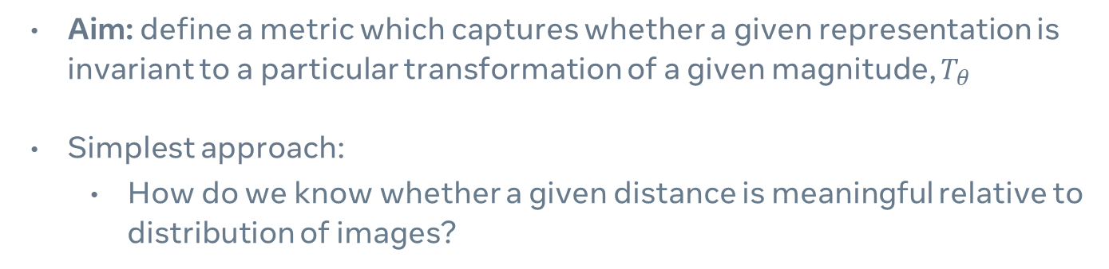
Measuring invariance
Aim: define a metric which captures whether a given representation is invariant to a particular transformation of a given magnitude, $T_{θ}$
Simplest approach:
How do we know whether a given distance is meaningful relative to distribution of images?

Slide 13
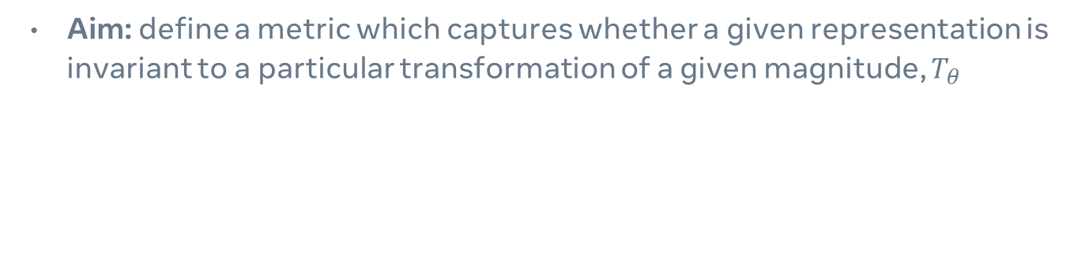
Measuring invariance
Aim: define a metric which captures whether a given representation is invariant to a particular transformation of a given magnitude, $T_{θ}$
Distance between embedding of image i and transformed image j
A value of 1 means a model is perfectly invariant as the distance between the embedding of the input and the transformed input is negligible relative to baseline distance between samples
A value of 0 means a model has no invariance as the distance between the embedding of the input and the transformed input is identical to the baseline distance between samples

Slide 14
Invariance to translation (x-axis)
More invariant
Less invariant
Stronger augmentations
Notes:
Training increases invariance to translation
Training w/o augmentations is a little worse, but almost identical to training w/ augs
Untrained vits show similar or greater translation invariance compared to resnets
Trained vits are just as translation invariant, if not more than CNNs

Slide 15
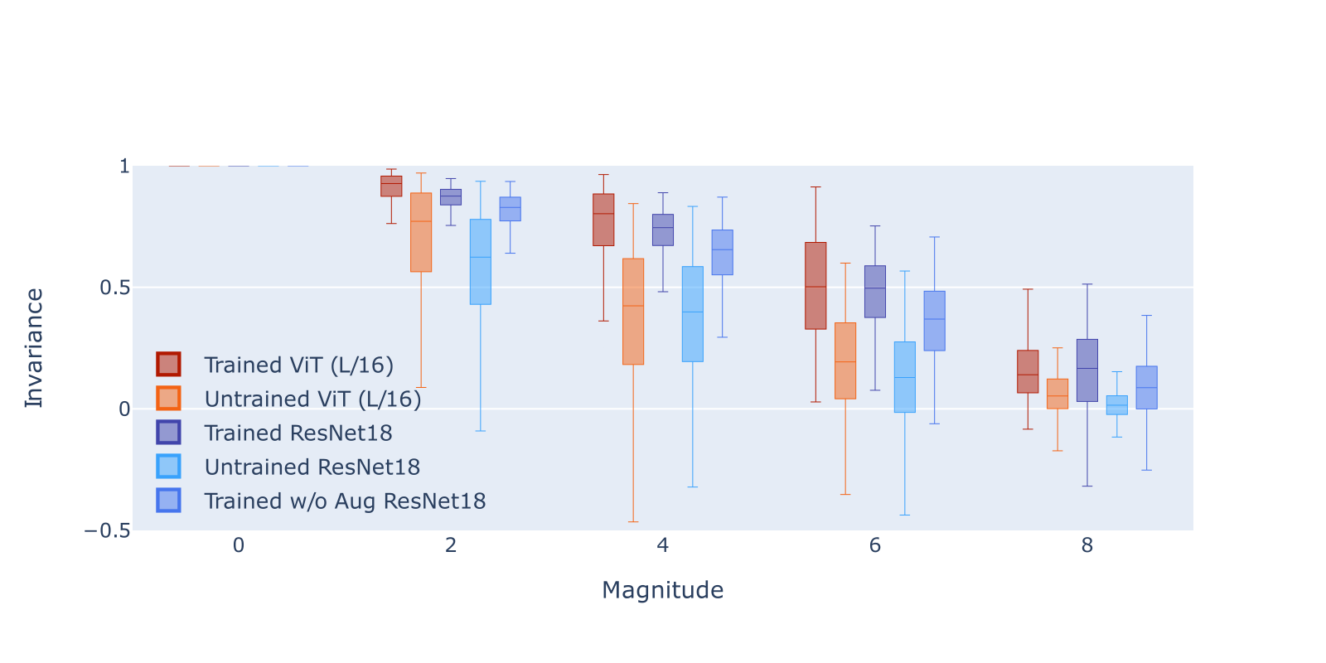
Invariance to translation (y-axis)
More invariant
Less invariant
Stronger augmentations

Slide 16
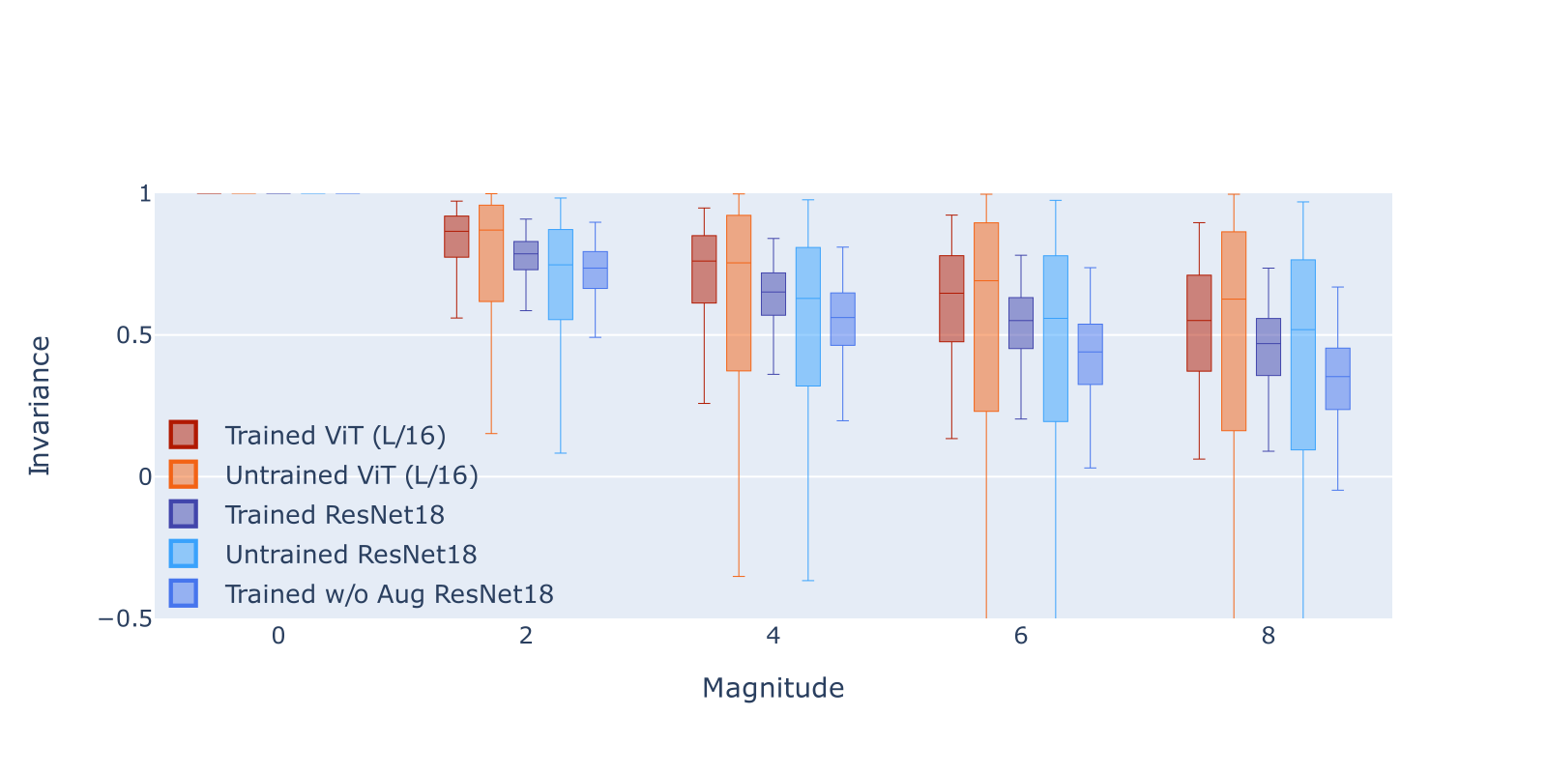
Training has minimal impact on scale invariance
More invariant
Less invariant
Stronger augmentations
Notes:
Training has minimal impact on scale

Slide 17
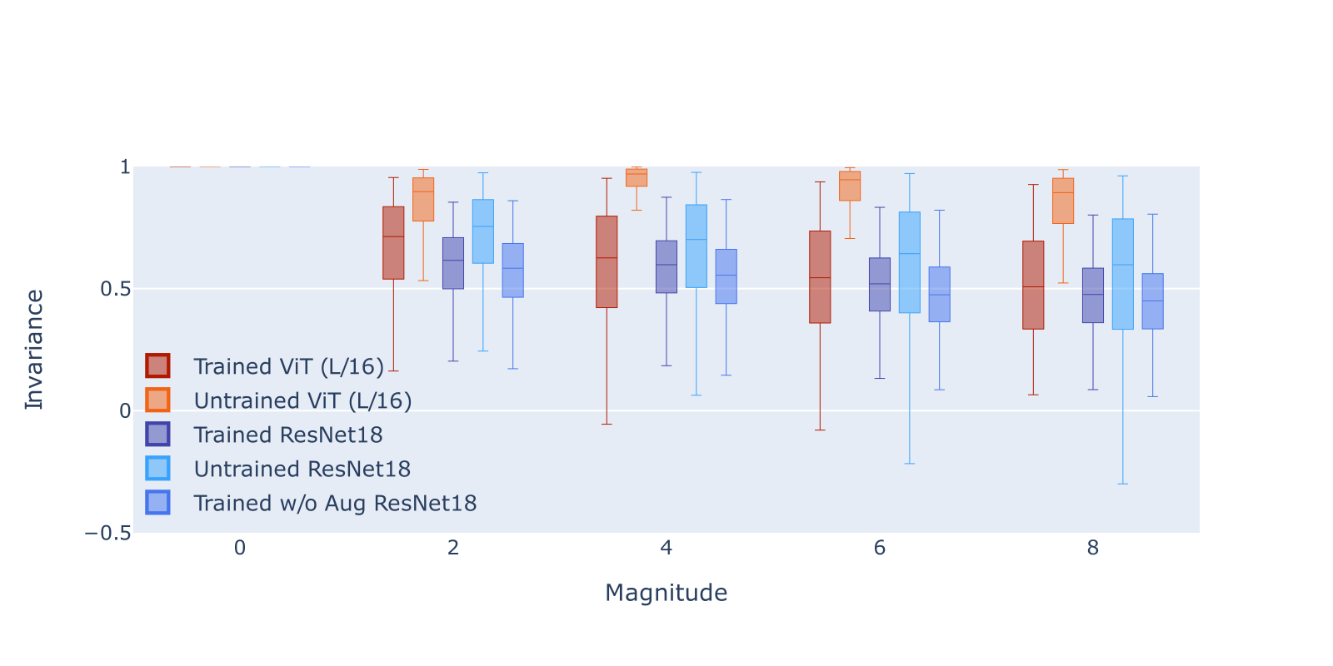
Training decreases rotation invariance
More invariant
Less invariant
Stronger augmentations
Notes:
Training decreases rotation invariance for vits and resnet

Slide 18
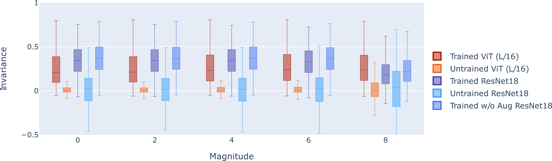
Training improves invariance to color distortion, though no appearance-based transformations present during training
More invariant
Less invariant
Stronger augmentations
Notes:
Training improves invariance to color distortion, though no color distortion present during training

Slide 19
Do learned invariances align with the factors of variation present in real data?

Slide 20
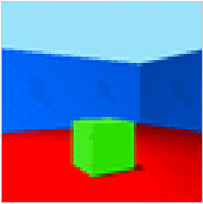
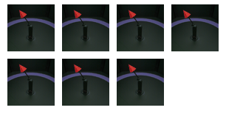

How do we characterize factors of variation in real data?
Methods to characterize factors of variation typically operate in synthetic data domains
dSprites
Higgins et al., 2017
3D shapes
Burgess and Kim, 2018
MPI3D
Gondal et al., 2019
However, it’s very difficult to characterize in realistic data, for which we don’t have access to the generative model of the data

Slide 21
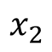
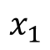
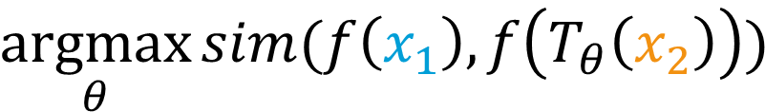
Our approach: similarity search
Aim: discover the transformations which characterize the (non-semantic) differences between images
$$\underset{θ}{argmax}{sim(f\left(x_{1}\right), f\left(T_{θ}\left(x_{2}\right)\right))}$$
$$x_{1}$$
Transformation pool:
AutoAugment subpolicies
(Cubuk et al., 2019)
$$x_{2}$$

Slide 22
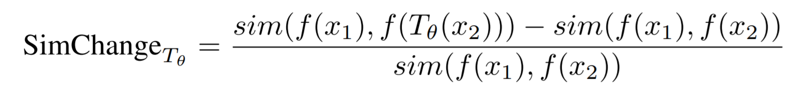
Our approach: similarity search
Advantages
Enables measurement of whether transformations can describe real data
Transformation pool linked to what’s possible with augmentation
Encompasses both geometric and appearance based transformations
Operates on relatively superficial transformations
Disadvantages
Operates on relatively superficial transformations
Limited ability to capture realistic abstract transformations
Difficult to make conclusions based on absolute metrics; have to use relative comparisons

Slide 23
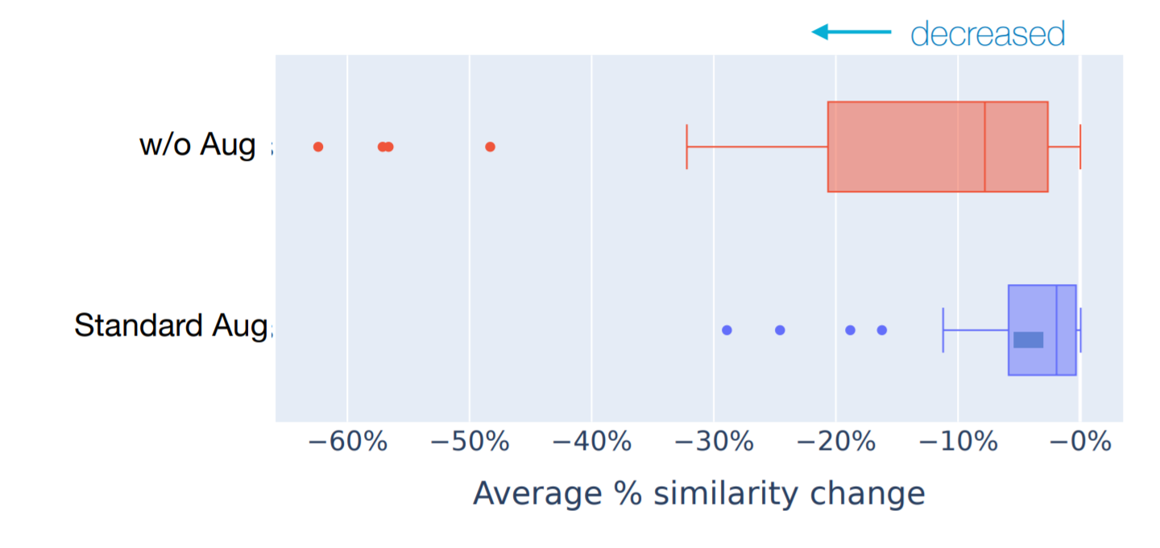
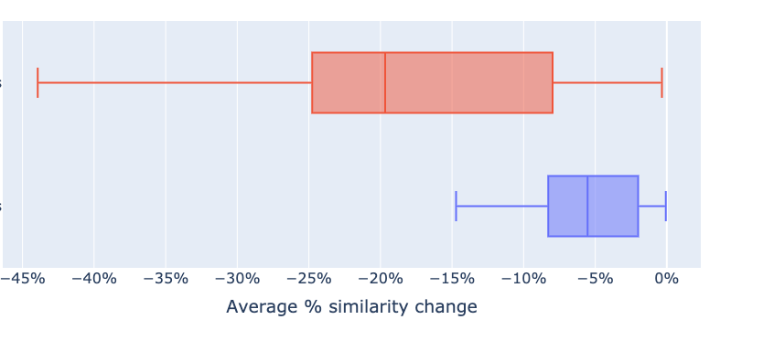
No single transformation or sub-policy increases pair similarity across classes
Individual transformations
Sub-policies of transformations

Slide 24
Training with augmentations decreases impact of transformation on similarity
Individual transformations
Sub-policies of transformations

Slide 25
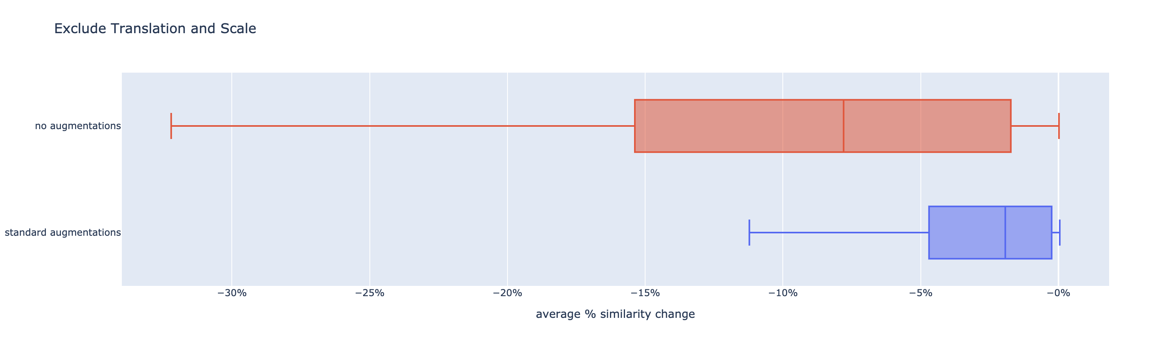
Training with augmentations decreases impact of transformation on similarity

Slide 26
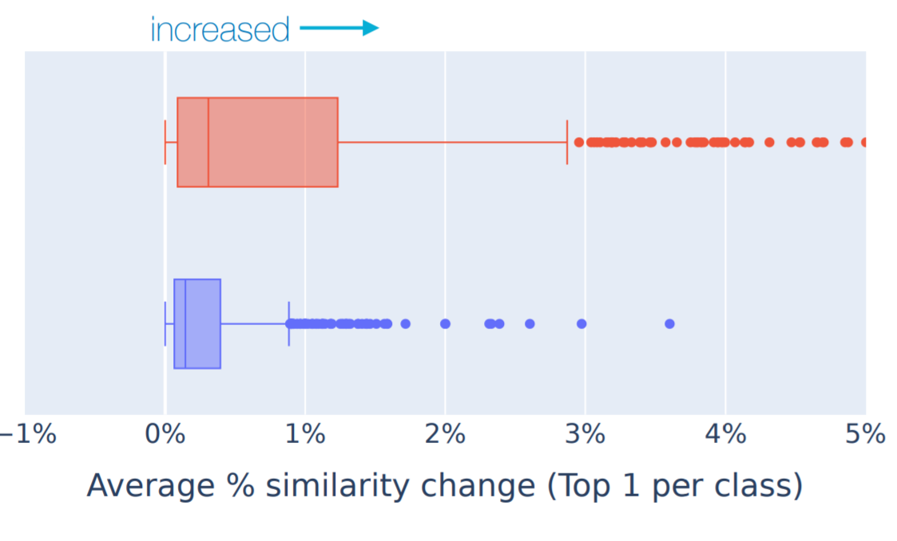
Per-class, there do exist transformations which systematically improve similarity

Slide 27
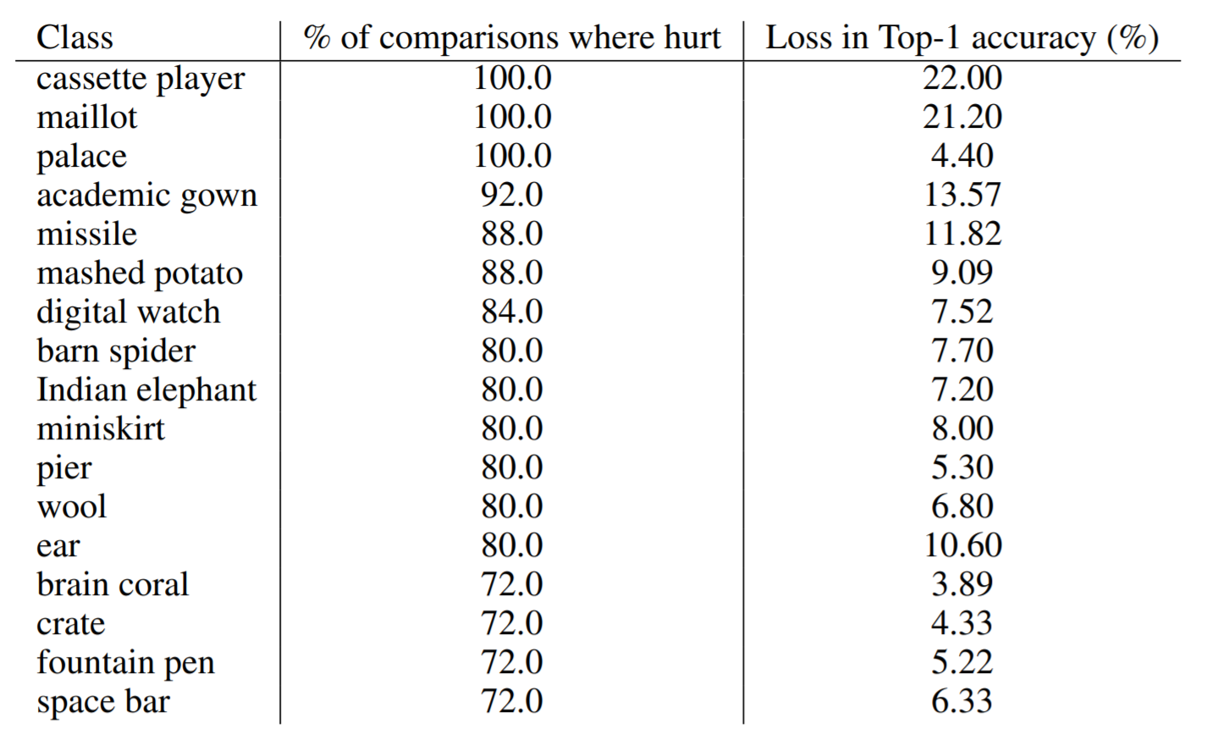
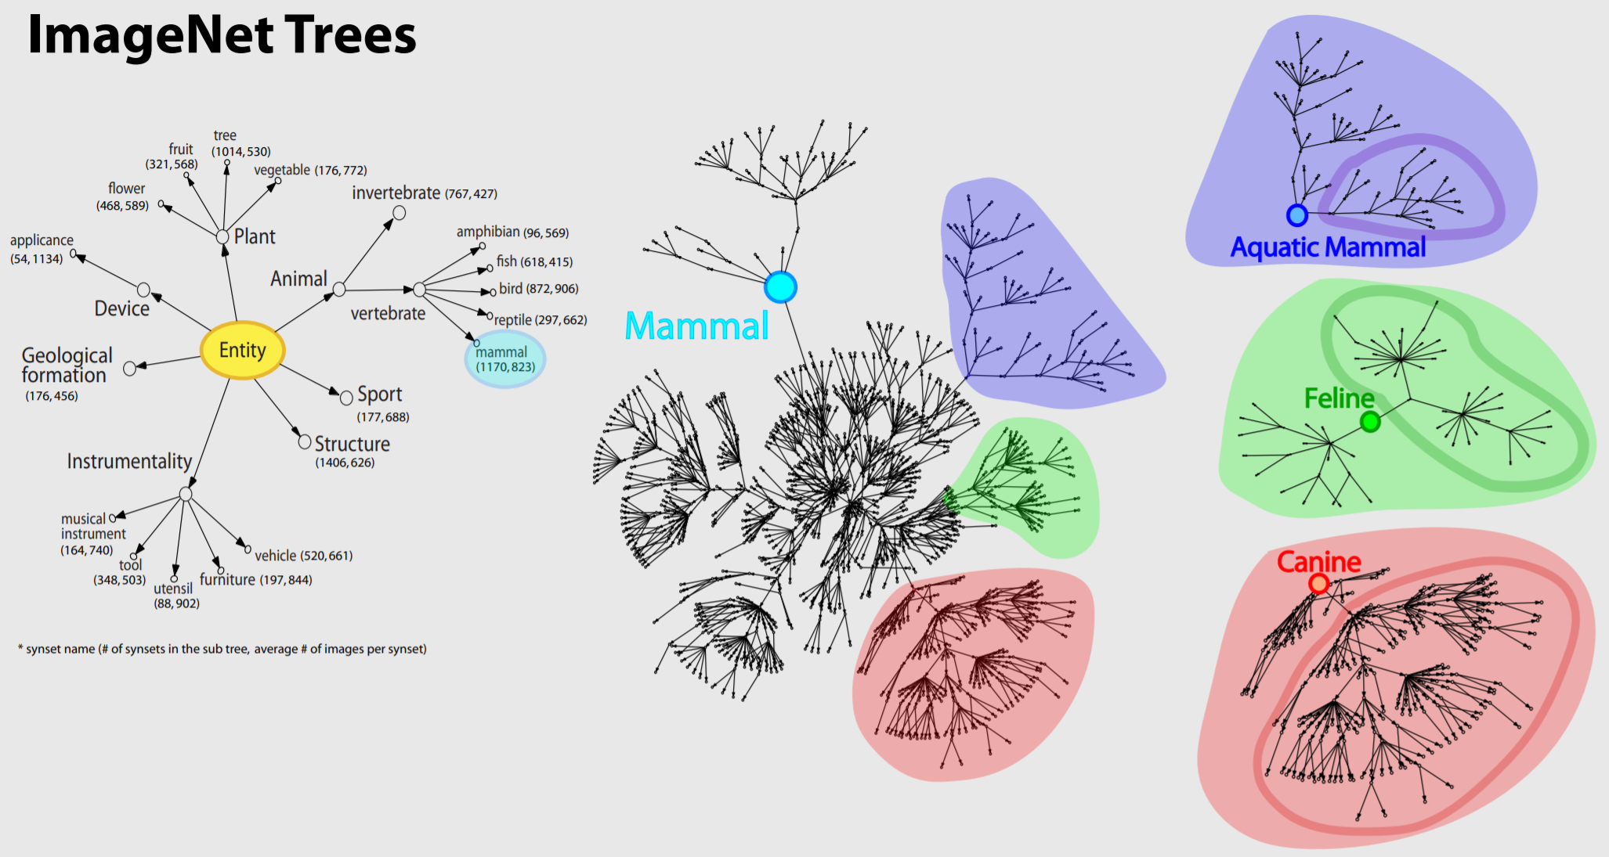
Some classes are consistently harmed by data augmentation
On average, 12.3% of classes exhibit decreased performance with RRC
No difference in wordnet similarity for classes which were consistently hurt or those that were consistently helped by RRC
Notes:
Since the optimal transformation differs across classes, what about standard augmentations across classes?

Slide 28
Appearance transforms are more prevalent than geometric transforms
78%
of top transforms are appearance-based

Slide 29
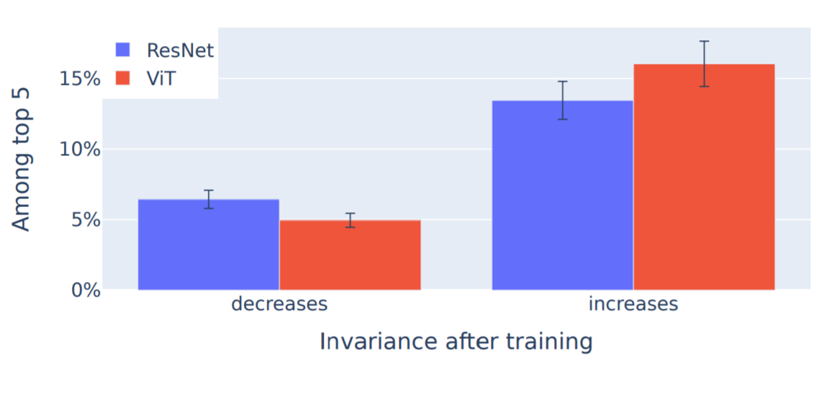
Training increases invariance for factors of variation
Top-ranked by similarity search
Change in measured invariance after training
This result suggests that training increases invariance to factors of variation present in real data regardless of whether there is an inductive bias or augmentation designed to encourage invariance
Major source of invariance is the data itself

Slide 30
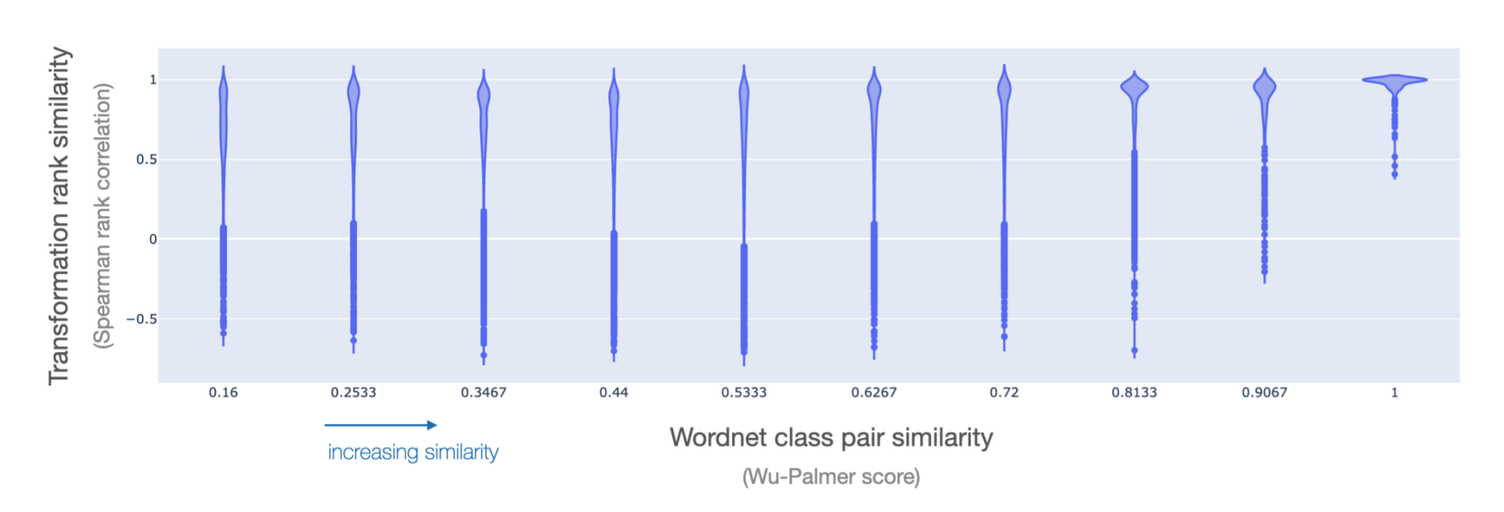
Transformations for similar classes are similar
Notes:
Wordnet not necessarily dissimilar for dissimilar classes
Similar with path similarity, Leacock-Chodorow Similar for ranks with interstion/union

Slide 31
Takeaways

Slide 32
Next steps
How do learned invariances change in other architectures, such as MLP-mixer?
How similar are transformations present in different image datasets?
Why does scaling have such a limited role?
Optimal transformations differed across classes: should we use different augmentations for different classes?
Can we intelligently select data subsets to encourage certain invariances?

Slide 33
Thank You

